Slide 1
Unit Starter
Lesson 3 - Words

Slide 2
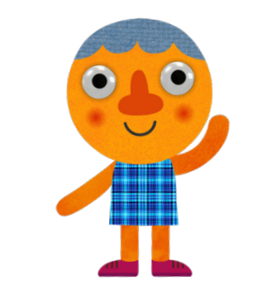
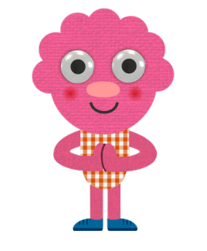
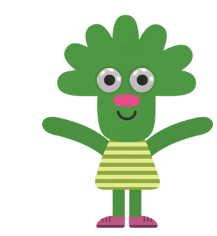
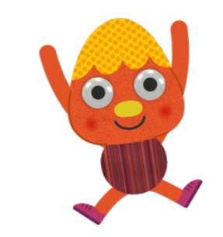
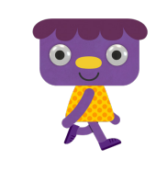
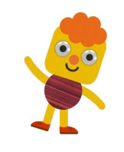
Give me Five

Slide 3
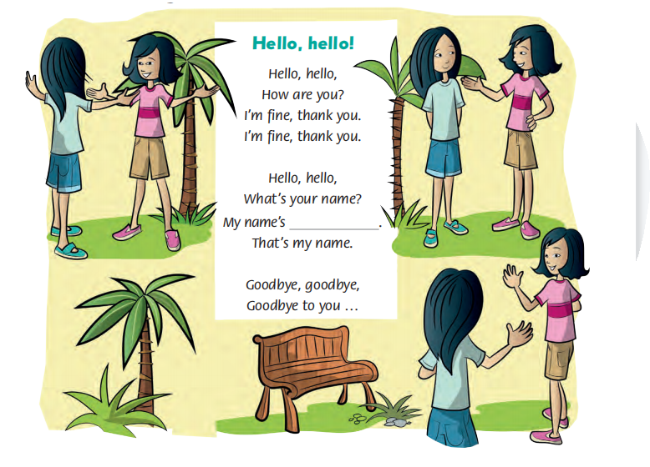
Let’s sing together.
This can be the part of the presentation where you introduce yourself, write your email...
Notes:
- Click Boy the hear the song.

Slide 4
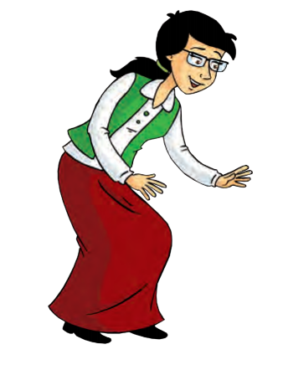
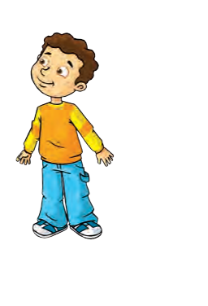
Speaking Time!!!
1
2
3
4
Hello!
What’s your name?
Hi. My name’s ....

Slide 5
Speaking time!!!
1
2
3
4
How old are you?
I’m nine years old.

Slide 6
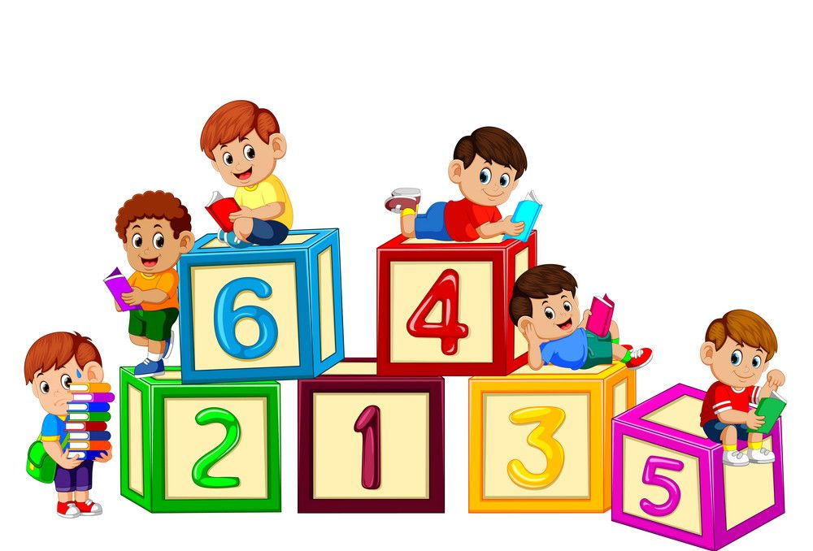
Numbers from 1 to 10

Slide 7
Notes:
- Click numbers to hear sound and the second click to see animations.
- Click chuot theo audio

Slide 8
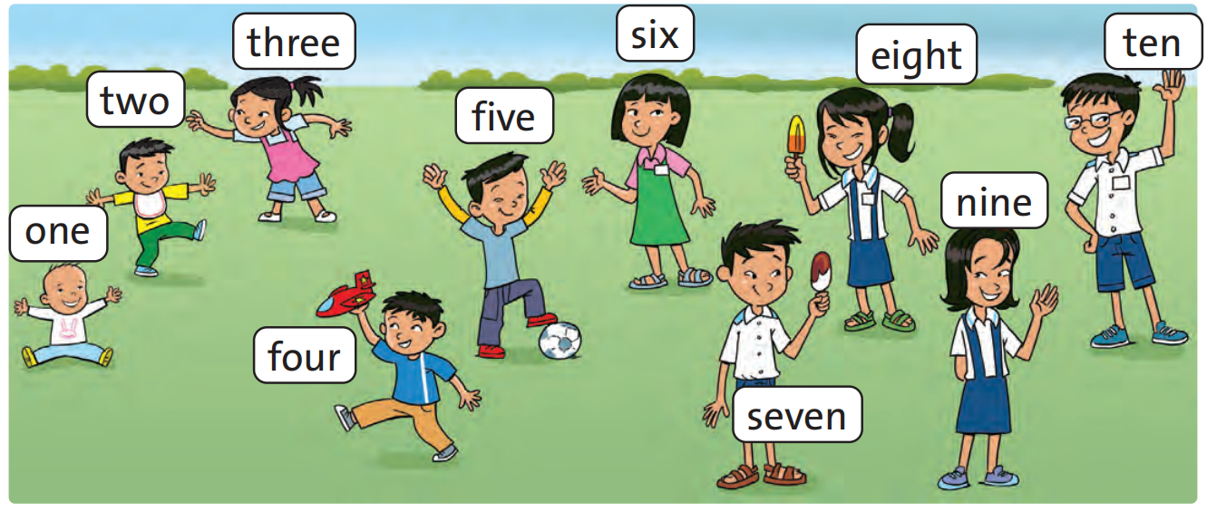
Look at the picture!!!

Slide 9
Look at the picture!!!

Slide 10
Let’s practice!!!

Slide 11
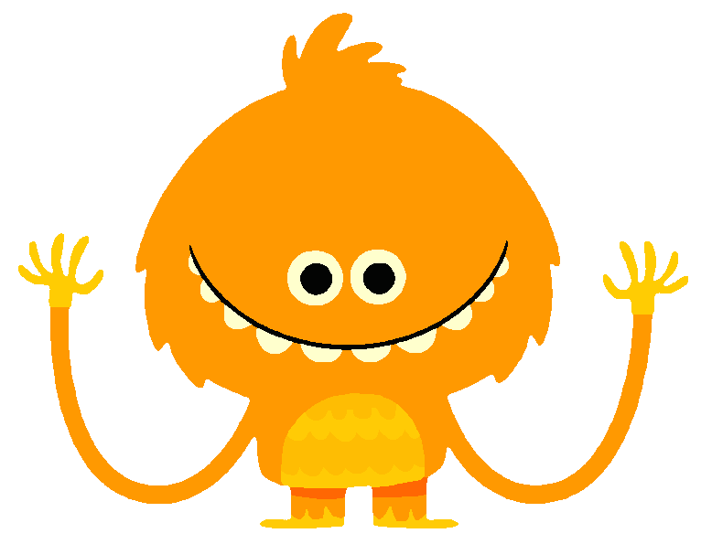
Look at the picture again. Point, ask and answer!!!
How old are you?
I’m eight.

Slide 12
Work in Pairs!!!

Slide 13
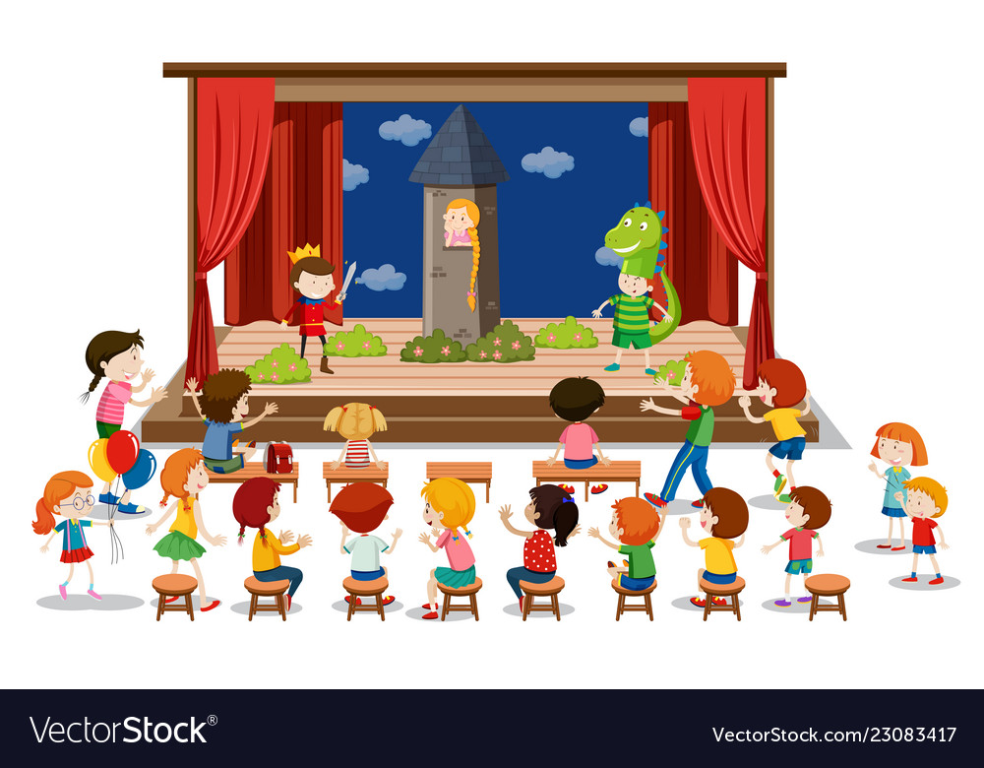
Welcome on stage!!!

Slide 14
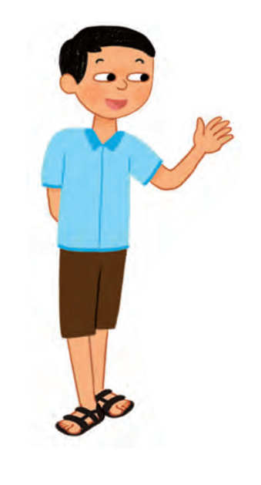
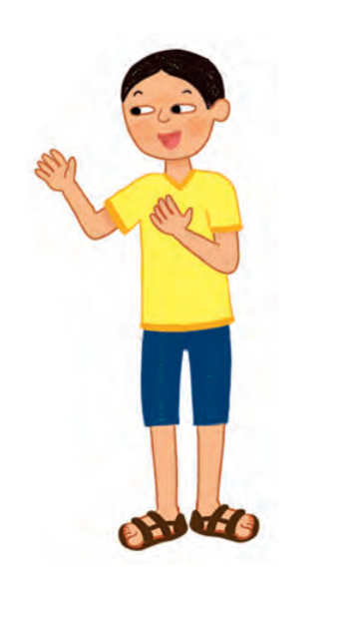
Ask and answer with your friend.
1
2
3
How old are you?
I’m ______.
And you?
I’m _____.

Slide 15
Let’s practice!!!

Slide 16
Welcome on stage!!!
How old are you?
I’m ______.
And you?
I’m _____.

Slide 17
How about you?
How old are you?

Slide 18
Let’s play!!!

Slide 19
Who is faster?
Notes:
- The student who says the number first is the winner.

Slide 20
Goodbye!!!

